Slide 1

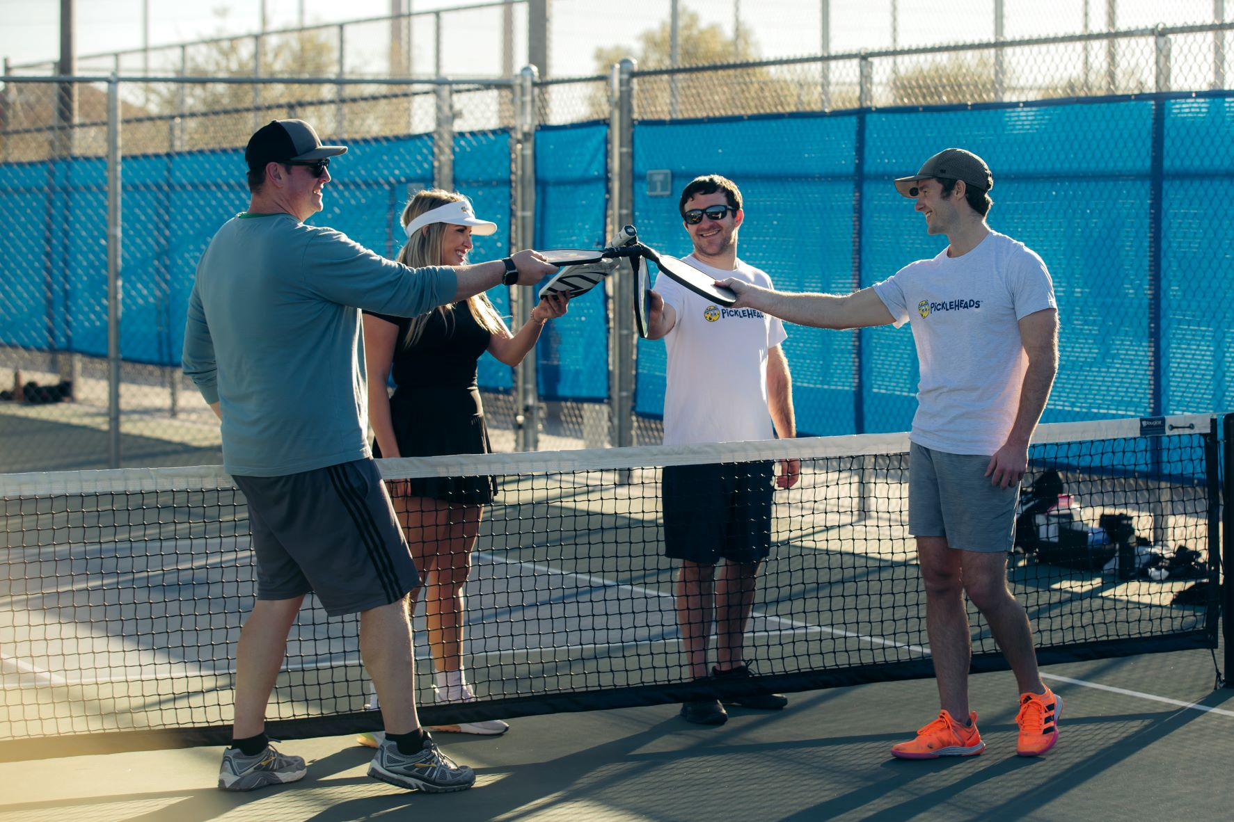
Facilities Data 2024
Facilities
Total Facilities in U.S.
15,043
Courts
Top State by Facility
Florida - 1,156
Top City by Facility
Houston, TX - 59

Slide 2
Courts Data 2024
Total Courts in U.S.
63,899
Top State by # of Courts
Florida - 5,667
Top City by # of Courts
Cincinnati, OH - 259
Facilities
Courts
Top 10 Cities by Courts Density 2024

